Slide 1
Medium Access Control
12.<number>
Copyright © The McGraw-Hill Companies, Inc. Permission required for reproduction or display.

Slide 2

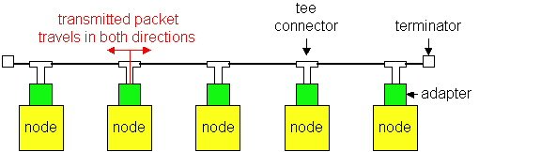
Figure 12.1 Data link layer divided into two functionality-oriented sublayers
12.<number>

Slide 3
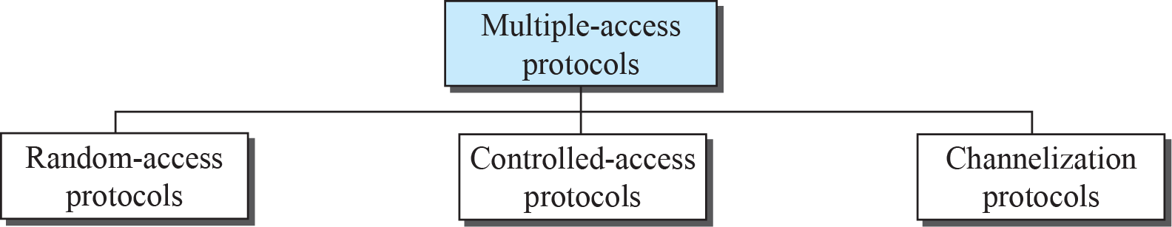
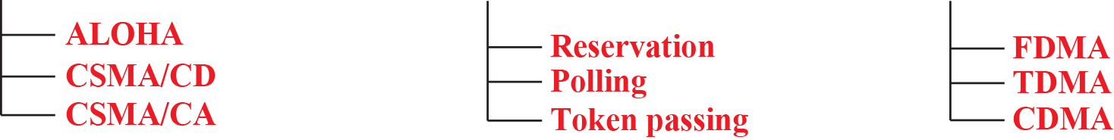
Figure 12.1: Taxonomy of multiple-access protocols
12.<number>
Notes:
12.#

Slide 4
Multiple Access
Problem: When two or more nodes transmit at the same time, their frames will collide and the link bandwidth is wasted during collision
  How to coordinate the access of multiple sending/receiving nodes to the shared link???
Solution: We need a protocol to coordinate the transmission of the active nodes
These protocols are called Medium Access Control (MAC) Protocols belong to a sublayer of the data link layer called MAC (Medium Access Control)
What is expected from Multiple Access Protocols:
  Main task is to minimize collisions in order to utilize the bandwidth by:
    Determining when a station can use the link (medium)
    what a station should do when the link is busy
    what the station should do when it is involved in collision
    How can the station determine success/failure of transmission

Slide 5
    12-1 RANDOM ACCESS
In random-access or contention no station is superior to another station and none is assigned control over another.
At each instance, a station that has data to send uses a procedure defined by the protocol to make a decision on whether or not to send.
This decision depends on the state of the medium (idle or busy).
No scheduled time for a station to transmit
Txn is random among stations.
No rules to specify which station should send next
Stations compete with one another to access medium
12.<number>
Notes:
12.#

Slide 6
Pure ALOHA
ALOHA, the earliest random access method, was developed at the University of Hawaii in early 1970. It was designed for a radio (wireless) LAN, but it can be used on any shared medium. It is obvious that there are potential collisions in this arrangement. The medium is shared between the stations. When a station sends data, another station may attempt to do so at the same time. The data from the two stations collide and become garbled.
12.<number>
Notes:
12.#

Slide 7
Pure ALOHA Protocol
  All frames from any station are of fixed length (L bits)
  Stations transmit at equal transmission time (all stations produce frames with equal frame lengths).
  A station that has data can transmit at any time
  After transmitting a frame, the sender waits for an acknowledgment for an amount of time (time out) equal to the maximum round-trip propagation delay = 2* t_{prop}(see next slide)
  If no ACK was received, sender assumes that the frame or ACK has been destroyed and resends that frame after it waits for a random amount of time
  If station fails to receive an ACK after repeated transmissions, it gives up
12.<number>

Slide 8

Figure 12.3 Frames in a pure ALOHA network
Each station send 2 frames…….Even if 1 bit of a frame coexist on channel
with 1 bit from another frame…collision..
Multiple frames in contention in shared medium
12.<number>

Slide 9

Figure 12.4 Procedure for pure ALOHA protocol
12.<number>

Slide 10
Example 12. 1
The stations on a wireless ALOHA network are a maximum of 600 km apart. If we assume that signals propagate at
3 × 10⁸ m/s,
find Tb if K=2
12.<number>

Slide 11
Example 12. 1
The stations on a wireless ALOHA network are a maximum of 600 km apart. If we assume that signals propagate at
3 × 10⁸ m/s,
we find T_{p} = (600 × 10³) / (3 × 10⁸) = 2 ms. For
K = 2, the range of R is {0, 1, 2, 3}. This means that T_{B} can be 0, 2, 4, or 6 ms, based on the outcome of the random variable R.
12.<number>

Slide 12
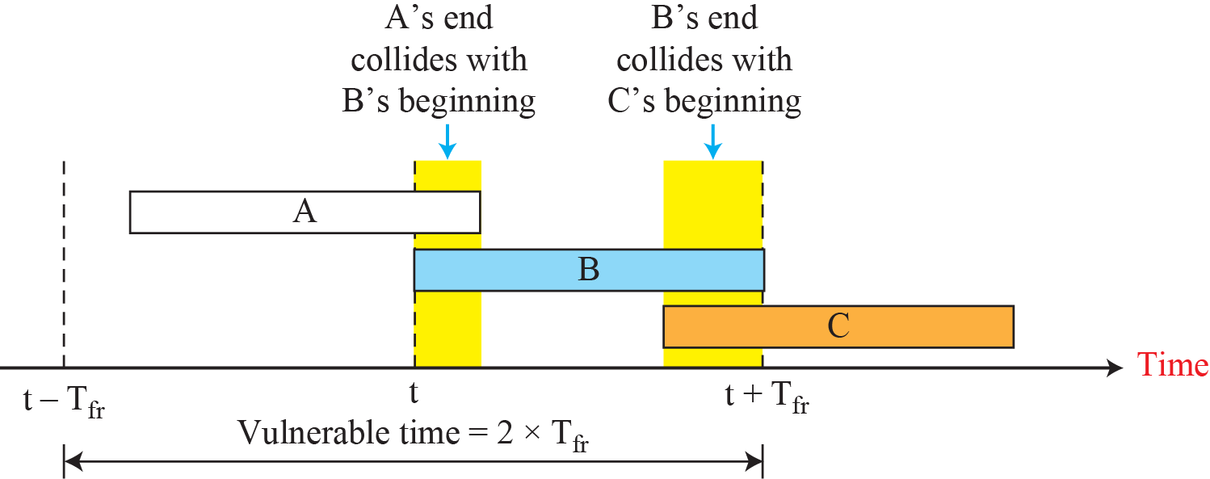
Figure 12.4: Vulnerable time for pure ALOHA protocol
Length of time for possibility of collision
If the frame transmission time is T sec, then the vulnerable time is = 2 T sec.
This means no station should send during the T-sec before this station starts transmission and no station should start sending during the T-sec period that the current station is sending.
12.<number>
Notes:
12.#

Slide 13
Example 12.2
A pure ALOHA network transmits 200-bit frames on a shared channel of 200 kbps. What is the requirement to make this frame collision-free?
Solution
Average frame transmission time T_{fr} is 200 bits/200 kbps or 1 ms. The vulnerable time is 2 × 1 ms = 2 ms. This means no station should send later than 1 ms before this station starts transmission and no station should start sending during the period (1 ms) that this station is sending.
12.<number>

Slide 14
Channel utilization or Efficiency or Throughput
  Percentage of the transmitted frames that arrive successfully (without collisions) or the percentage of the channel bandwidth that will be used for transmitting frames without collisions
ALOHA Maximum channel utilization
  18% (i.e, if the system produces F frames/s, then 0.18 * F frames will arrive successfully on average without the need of retransmission).
12.<number>

Slide 15

One-half frame generated during one frame txn time
Or 1 frame during 2 frame txn time.
Station generating only 1 frame in vulnerable time
Note
The throughput ( S) for pure ALOHA is
S = G × e ^{−2G} .
The maximum throughput
S_{max} = 0.184 when G= (1/2).
G = Average number of frames generated by the system (all stations) during one frame transmission time

Slide 16
Example 12.3
A pure ALOHA network transmits 200-bit frames on a shared channel of 200 kbps. What is the throughput if the system (all stations together) produces
a. 1000 frames per second?
b. 500 frames per second?
c. 250 frames per second?
12.<number>

Slide 17
Example 12.3
A pure ALOHA network transmits 200-bit frames on a shared channel of 200 kbps. What is the throughput if the system (all stations together) produces
a. 1000 frames per second?
b. 500 frames per second?
c. 250 frames per second?
Solution
The frame transmission time is 200/200 kbps or 1 ms.
a. If the system creates 1000 frames per second, or 1 frame
per millisecond, then G = 1. In this case S = G × e^{−2G} =
0.135 (13.5 percent). This means that the throughput is
1000 × 0.135 = 135 frames. Only 135 frames out of 1000
will probably survive.
12.<number>

Slide 18
Example 12.3 (continued)
b. If the system creates 500 frames per second, or 1/2 frames
per millisecond, then G = 1/2. In this case S = G × e^{−2G}
= 0.184 (18.4 percent). This means that the throughput is
500 × 0.184 = 92 and that only 92 frames out of 500 will
probably survive. Note that this is the maximum
throughput case, percentage-wise.
c. If the system creates 250 frames per second, or 1/4
frames per millisecond, then G = 1/4. In this case S =
G × e^{−2G} = 0.152 (15.2 percent). This means that the
throughput is 250 × 0.152 = 38. Only 38 frames out of
250 will probably survive
12.<number>

Slide 19
Random Access – Slotted ALOHA
Time is divided into slots equal to a frame transmission time (T_{fr})
A station can transmit at the beginning of a slot only
If a station misses the beginning of a slot, it has to wait until the beginning of the next time slot.
A central clock or station informs all stations about the start of a each slot
Maximum channel utilization is 37%

Slide 20

Figure 12.6 Frames in a slotted ALOHA network
12.<number>

Slide 21

In danger time for slotted ALOHA protocol

Slide 22
Note
The throughput for slotted ALOHA is
S = G × e^{−G} .
The maximum throughput
S_{max} = 0.368 when G = 1.

Slide 23
Example 12.4
A slotted ALOHA network transmits 200-bit frames using a shared channel with a 200-kbps bandwidth. Find the throughput if the system (all stations together) produces
a. 1000 frames per second.
b. 500 frames per second.
c. 250 frames per second.
Solution
This situation is similar to the previous exercise except that the network is using slotted ALOHA instead of pure ALOHA. The frame transmission time is 200/200 kbps or 1 ms.
12.<number>

Slide 24
Example 12.4 (continued)
In this case G is 1. So S = G × e^{−G} = 0.368 (36.8
percent). This means that the throughput is 1000 × 0.0368 = 368 frames. Only 368 out of 1000 frames will probably survive. Note that this is the maximum throughput case, percentage-wise.
Here G is 1/2. In this case S = G × e^{−G} = 0.303 (30.3 percent). This means that the throughput is 500 × 0.0303 = 1512. Only 151 frames out of 500 will probably survive.
Now G is 1/4. In this case S = G × e^{−G} = 0.195 (19.5 percent). This means that the throughput is 250 × 0.195 = 49. Only 49 frames out of 250 will probably survive.
12.<number>

Slide 25
Efficiency of Aloha
0.4
0.3
S = throughput =(success rate)
Slotted Aloha
0.2
0.1
Pure Aloha
0.5
1.0
1.5
2.0
G = offered load rate= new frames+ retransmitted
= Total frames presented to the link per
the transmission time of a single frame

Slide 26
12.1.2 CSMA
To minimize the chance of collision and, therefore, increase the performance, the CSMA method was developed.
The chance of collision can be reduced if a station senses the medium before trying to use it.
Carrier sense multiple access (CSMA) requires that each station first listen to the medium (or check the state of the medium) before sending. In other words, CSMA is based on the principle “sense before transmit” or “listen before talk.”
12.<number>
Notes:
12.#

Slide 27
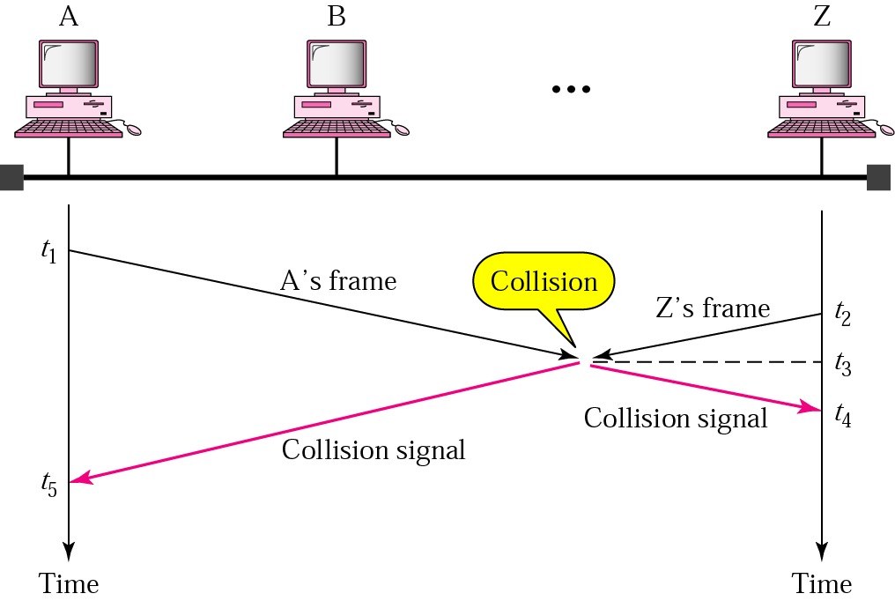
Random Access – Carrier Sense Multiple Access (CSMA)
To improve performance, avoid transmissions that are certain to cause collisions
Based on the fact that in LAN propagation time is very small
➔ If a frame was sent by a station, All stations knows immediately so they can wait before start sending
  ➔ A station with frames to be sent, should sense the medium for the presence of another transmission (carrier) before it starts its own transmission
This can reduce the possibility of collision but it cannot eliminate it.
  Collision can only happen when more than one station begin transmitting within a short time (the propagation time period)

Slide 28
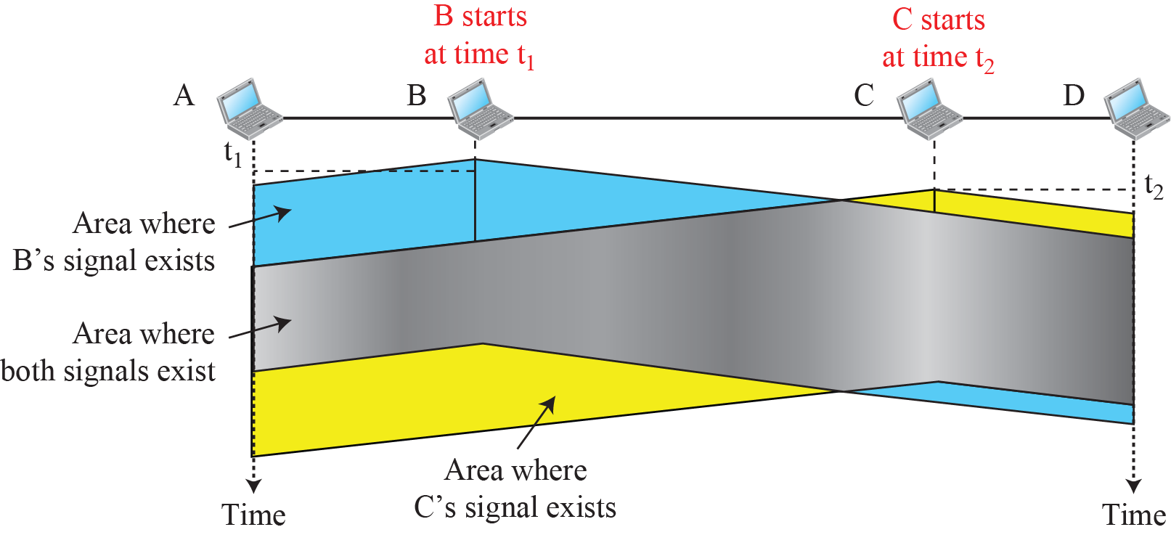
Figure 12.7: Space/time model of a collision in CSMA
12.<number>
Notes:
12.#

Slide 29

Random Access – Carrier Sense Multiple Access (CSMA)
Vulnerable time for CSMA is the maximum propagation time
The longer the propagation delay, the worse the performance of the protocol

Slide 30
Types of CSMA Protocols
  Different CSMA protocols that determine:
  What a station should do when the medium is idle?
  What a station should do when the medium is busy?
    Non-Persistent CSMA
    1-Persistent CSMA
    p-Persistent CSMA

Slide 31
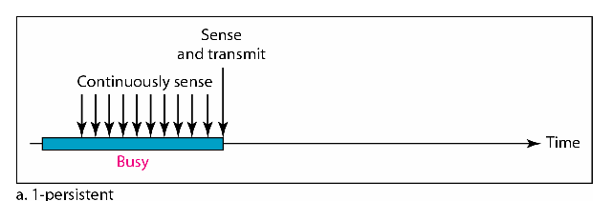
1-persistent CSMA
To avoid idle channel time, 1-persistent protocol used
Station wishing to transmit listens to the medium:
  If medium idle, transmit immediately;
  If medium busy, continuously listen until medium becomes idle; then transmit immediately with probability 1
Performance
  1-persistent stations are selfish
  If two or more stations becomes ready at the same time, collision guaranteed

Slide 32
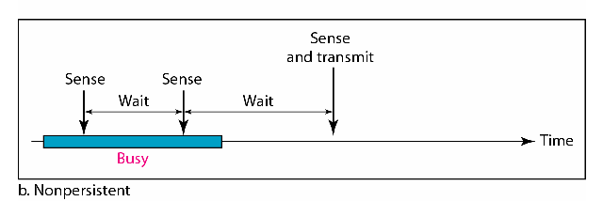
Nonpersistent CSMA
A station with frames to be sent, should sense the medium
  If medium is idle, transmit; otherwise, go to 2
  If medium is busy, (backoff) wait a random amount of time and repeat 1
Performance:
  Random delays reduces probability of collisions because two stations with data to be transmitted will wait for different amount of times.
  Bandwidth is wasted if waiting time (backoff) is large because medium will remain idle following end of transmission even if one or more stations have frames to send
Random Waiting times
Wasted time

Slide 33
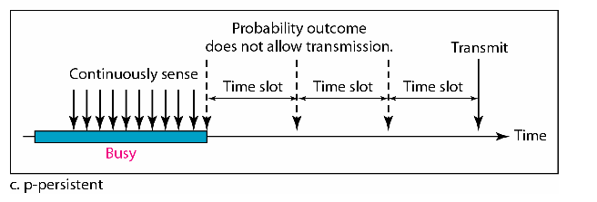
p-persistent CSMA
Time is divided to slots where each Time unit (slot) typically equals maximum propagation delay
Station wishing to transmit listens to the medium:
If medium idle,
  transmit with probability (p), OR
  wait one time unit (slot) with probability (1 – p), then repeat 1.
If medium busy, continuously listen until idle and repeat step 1
Performance
  Reduces the possibility of collisions like nonpersistent
  Reduces channel idle time like 1-persistent

Slide 34

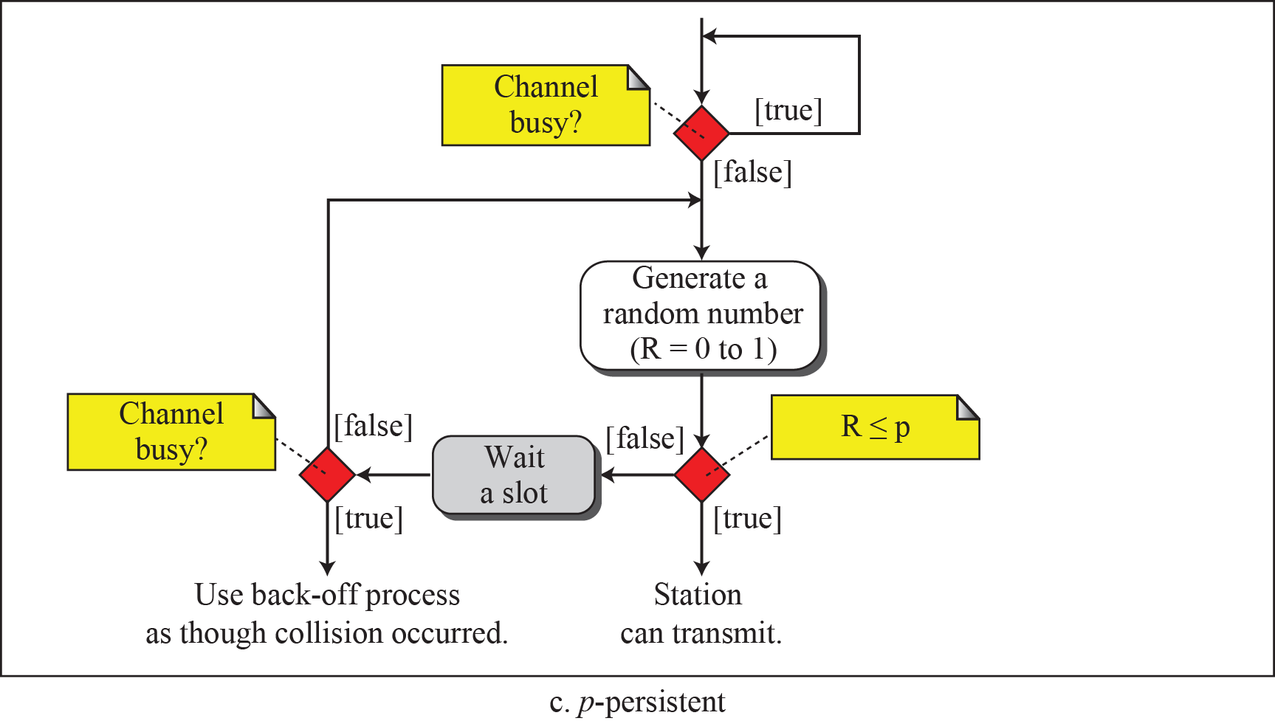
Flow diagram for three persistence methods

Slide 35
12.1.3 CSMA/CD
The CSMA method does not specify the procedure following a collision. Carrier sense multiple access with collision detection (CSMA/CD) augments the algorithm to handle the collision.
In this method, a station monitors the medium after it sends a frame to see if the transmission was successful. If so, the station is finished. If, however, there is a collision, the frame is sent again.
12.<number>
Notes:
12.#

Slide 36
CSMA/CD (Collision Detection)
CSMA (all previous methods) has an inefficiency:
  If a collision has occurred, the channel is unstable until colliding packets have been fully transmitted
CSMA/CD (Carrier Sense Multiple Access with Collision Detection) overcomes this as follows:
  While transmitting, the sender is listening to medium for collisions.
  Sender stops transmission if collision has occurred reducing channel wastage .
  CSMA/CD is Widely used for bus topology LANs (IEEE 802.3, Ethernet).

Slide 37
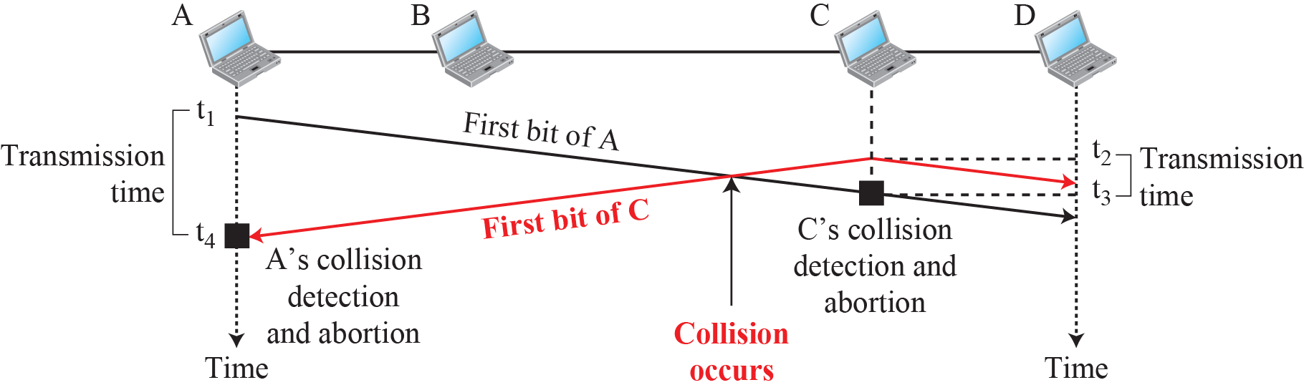
Figure 12.11: Collision of the first bits in CSMA/CD
t1 , t2 – persistence
Collision after t2
12.<number>
Notes:
12.#

Slide 38
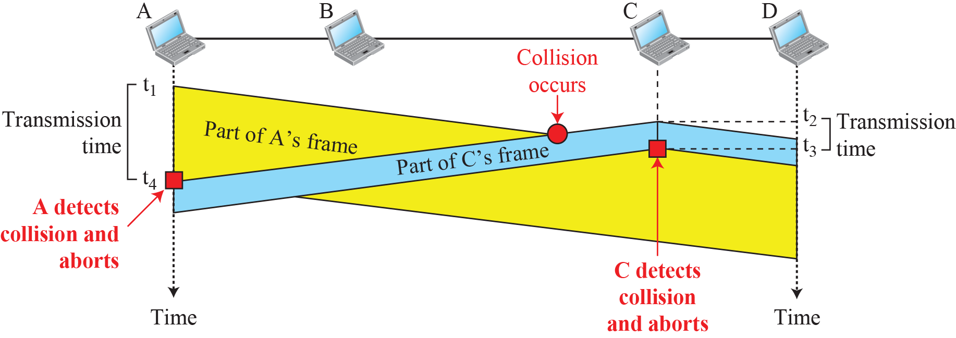
Figure 12.12: Collision and abortion in CSMA/CD
Minimum Frame size?
12.<number>
Notes:
12.#

Slide 39
Minimum Frame Size
For CSMA/CD to work
  Restriction in Frame size
Before sending last bit of frame
  Sending station must detect a collision (if any)
  Abort the transmission
Once frame is sent, does not keep copy of frame and does not monitor the line for collision detection
12.<number>

Slide 40
Frame Transmission Time
Must be atleast 2 times the maximum propagation time
Worst cast scenario
  Effect of collision takes another Tp time
  Requirement is to keep transmitting after 2Tp
12.<number>

Slide 41
Example 12.5
A network using CSMA/CD has a bandwidth of 10 Mbps. If the maximum propagation time is 25.6 μs, what is the minimum size of the frame?
Solution
The minimum frame transmission time is T_{fr} = 2 × T_{p} = 51.2 μs. This means, in the worst case, a station needs to transmit for a period of 51.2 μs to detect the collision. The minimum size of the frame is 10 Mbps × 51.2 μs = 512 bits or 64 bytes. This is actually the minimum size of the frame for Standard Ethernet
12.<number>

Slide 42
CSMA/CD Protocol
Use one of the CSMA persistence algorithm
(non-persistent, 1-persistent, p-persistent) for transmission
If a collision is detected by a station during its transmission then it should do the following:
  Abort transmission and
  Transmit a jam signal (48 bit) to notify other stations of collision so that they will discard the transmitted frame also to make sure that the collision signal will stay until detected by the furthest station
  After sending the jam signal, backoff (wait) for a random amount of time, then
  Transmit the frame again
Frame transmission time should be at least as long as the time needed to detect a collision (2 * maximum propagation delay

Slide 43

Figure 12.15 Energy level during transmission, idleness, or collision
3 levels of energy in channel
Zero, Normal (successfully captured), Abnormal
12.<number>

Slide 44

Figure 12.14 Flow diagram for the CSMA/CD
Make sure all stations are aware
of collision
12.<number>

Slide 45
Exponential Backoff Algorithm
Ethernet uses the exponential backoff algorithms to determine the best duration of the random waiting period after the collision happens
Algorithm:
  After K^{th} collision, select a random number (R) between 0 and
  2^{k} –1 and wait for a period equal to (R*slot time) then retransmit when the medium is idle, for example:
    After first collision (K=1), select a number (R) between 0 and 2¹ –1 {0 ,1} and wait for a period equal to R*slot times (Wait for a period 0 usec or 1x51.2 usec) then retransmit when the medium is idle
  Do not increase random number range, if K=10
    ➔ Maximum interval {0 – 1023}
  Give up after 16 unsuccessful attempts and report failure to higher layers

Slide 46
Exponential Backoff Algorithm
Reduces the chance of two waiting stations picking the same random waiting time
When network traffic is light, it results in minimum waiting time before transmission
As congestion increases ( traffic is high), collisions increase, stations backoff by larger amounts to reduce the probability of collision.
Exponential Back off algorithm gives last-in, first-out effect
  Stations with no or few collisions will have the chance to transmit before stations that have waited longer because of their previous unsuccessful transmission attempts.

Slide 47
CSMA/CA Protocol
Wired Network
  Received signal energy ~ sent signal energy
  Length of cable short
  Repeaters (PHY)
  Collision detected – OK!
Wireless Network
  Received signal energy – lost in txn
  CD not effective
  basic principles of CSMA/CA are listen before talk and contention
  IFS (Avoid collisions by deferring txns even if channel is idle), Contention Window, Acknowledgements
12.<number>

Slide 48

Figure 12.16 Timing in CSMA/CA
• Whenever the channel is found idle, the station does not transmit immediately. It waits for a period of time called interframe space (IFS).
• When channel is sensed to be idle, it may be possible that same distant station may have already started transmitting and the signal of that distant station has not yet reached other stations.
• Therefore the purpose of IFS time is to allow this transmitted signal to reach other stations.
• If after this IFS time, the channel is still idle, the station can send, but it still needs to wait a time equal to contention time.
• IFS variable can also be used to define the priority of a station or a frame.
Contention window is an amount of time divided into slots.
12.<number>

Slide 49
Note
In CSMA/CA, the IFS can also be used to define the priority of a station or a frame.
12.<number>

Slide 50
Contention window
  Amount of time divided into slots.
  A station that is ready to send chooses a random number of slots as its wait time.
  The number of slots in the window changes according to the binary exponential back-off strategy.
  This is very similar to the p-persistent method except that a random outcome defines the number of slots taken by the waiting station.
    In contention window the station needs to sense the channel after each time slot.
    If the station finds the channel busy, it does not restart the process. It just stops the timer & restarts it when the channel is sensed as idle.
12.<number>

Slide 51

Figure 12.17 Flow diagram for CSMA/CA
12.<number>

Slide 52
Note
Despite all the precautions, collisions may occur and destroy the data. Positive acknowledgment and the time-out timer can help guarantee that receiver has received the frame
12.<number>

Slide 53
Performance of Random Access Protocols
Simple and easy to implement
Decentralized (no central device that can fail and bring down the entire system)
In low-traffic, packet transfer has low-delay
However, limited throughput and in heavier traffic, packet delay has no limit.
In some cases, a station may never have a chance to transfer its packet. (unfair protocol)
A node that has frames to be transmitted can transmit continuously at the full rate of channel (R) if it is the only node with frames
If (M) nodes want to transmit, many collisions can occur and the rate for each node will not be on average R/M

Slide 54
12-2 CONTROLLED ACCESS
Stations consult one another to find which station has the right to send.
A station cannot send unless it has been authorized by other stations.
Topics discussed in this section:
Reservation
Polling
Token Passing
12.<number>

Slide 55
Controlled Access or Scheduling
Provides in order access to shared medium so that every station has chance to transfer (fair protocol)
Eliminates collision completely
Three methods for controlled access:
  Reservation
  Polling
  Token Passing

Slide 56
12.2.1 Reservation
In the reservation method, a station needs to make a reservation before sending data.
Time is divided into intervals.
In each interval, a reservation frame precedes the data frames sent in that interval.
12.<number>
Notes:
12.#

Slide 57

1-Reservation access method
Stations take turns transmitting a single frame at a full rate ( R ) bps
Transmissions are organized into variable length cycles
Each cycle begins with a reservation interval that consists of (N) minislots. One minislot for each of the N stations
When a station needs to send a data frame, it makes a reservation in its own minislot.
By listening to the reservation interval, every station knows which stations will transfer frames, and in which order.
The stations that made reservations can send their data frames after the reservation frame.

Slide 58
Figure 12.18 Reservation access method
12.<number>

Slide 59
12.2.2 Polling
Polling works with topologies in which
  one device is designated as a primary station and the other devices are secondary stations.
All data exchanges must be made through the primary device even when the ultimate destination is a secondary device.
Primary device controls the link;
Secondary devices follow its instructions.
It is up to the primary device to determine which device is allowed to use the channel at a given time.
12.<number>
Notes:
12.#

Slide 60
2- Polling
Stations take turns accessing the medium
Centralized polling
  One device is assigned as primary station and the others as secondary stations
  All data exchanges are done through the primary
  When the primary has a frame to send it sends a select frame that includes the address of the intended secondary
  When the primary is ready to receive data it send a Poll frame for each device to ask if it has data to send or not. If yes, data will be transmitted otherwise NAK is sent.
  Polling can be done in order (Round-Robin) or based on predetermined order

Slide 61


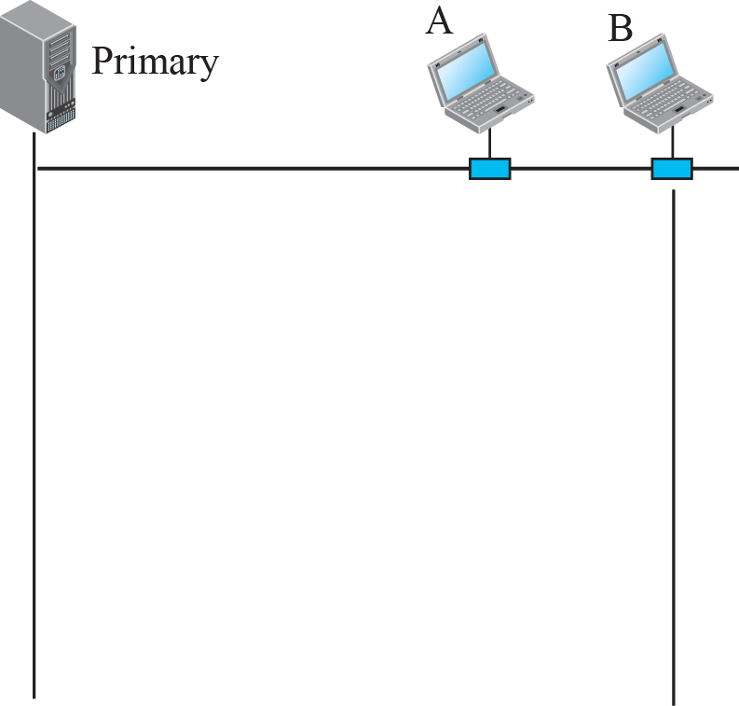
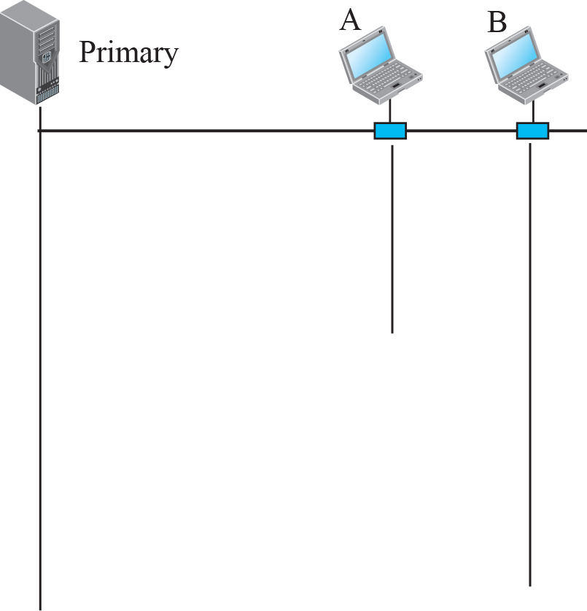





Figure 12.19: Select and poll functions in polling-access method
primary wants to send data
primary wants to receive data
12.<number>
Notes:
12.#

Slide 62
12.2.3 Token Passing
In the token-passing method, the stations in a network are organized in a logical ring.
For each station, there is a predecessor and a successor.
The current station is the one which is accessing the channel now
Right to access the channel – Passed from one station to another – Special Packet – TOKEN
  WAIT until receive the token from Predecessor
  HOLD Token and send data ; Release : no more data
12.<number>
Notes:
12.#

Slide 63
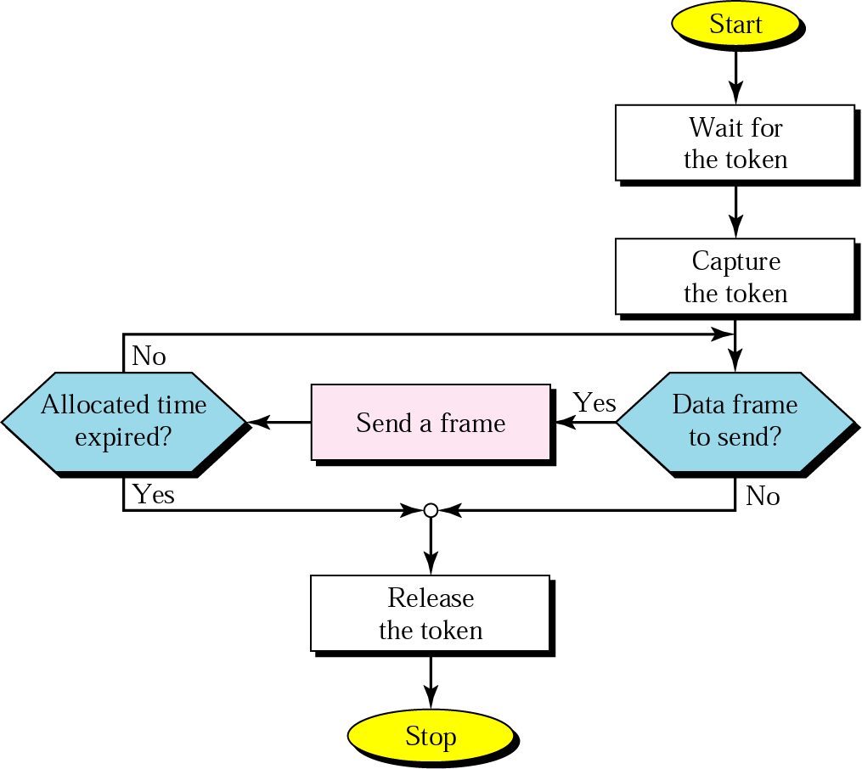
Figure 13.13 Token-passing procedure

Slide 64
Token Management
Stations limited in time for possession of token
  Monitor token to ensure it has not been lost/destroyed
  Station holding token fails : token disappears
  Assign Priorities to stations : type of data being transmitted
  Token management : release token from low-priority to high priority
12.<number>

Slide 65
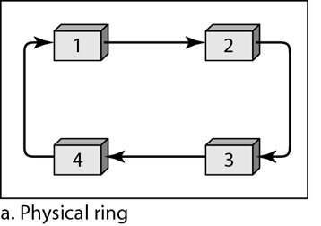
Logical ring and physical topology in token-passing access method
Whole system fails if medium bet fails!
Station sends token to it’s successor
; Token cannot be seen by other stations
; Address of next successor not needed
12.<number>

Slide 66
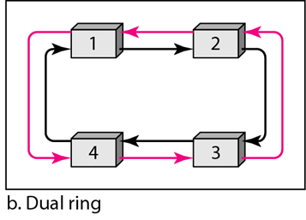
Logical ring and physical topology in token-passing access method
Auxiliary Ring – reverse direction
2 Tx/Rx Ports
High Speed Token Ring
FDDI / CDDI use this topology
12.<number>

Slide 67
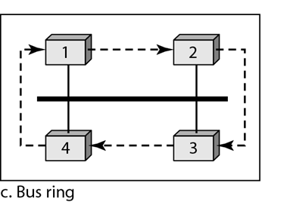
Logical ring and physical topology in token-passing access method
Release the token – insert address of successor
12.<number>
Token Bus LAN

